Slide 1



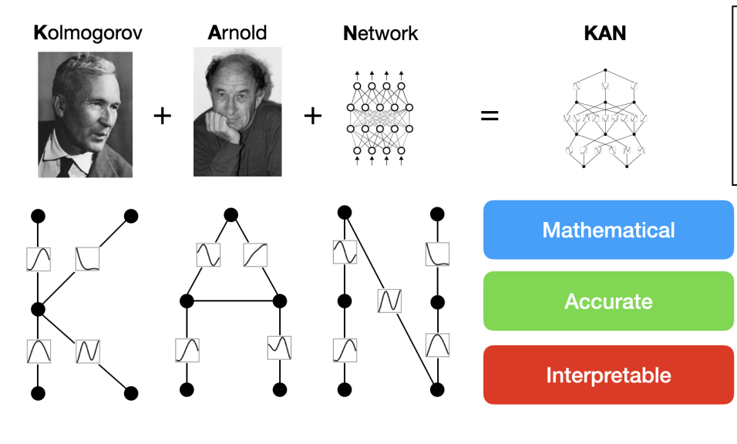

Kolmogorov–Arnold Networks
Author (s): Ziming Liu et al.
Massachusetts Institute of Technology
California Institute of Technology
Northeastern University
The NSF Institute for Artificial Intelligence and Fundamental Interactions

Slide 2
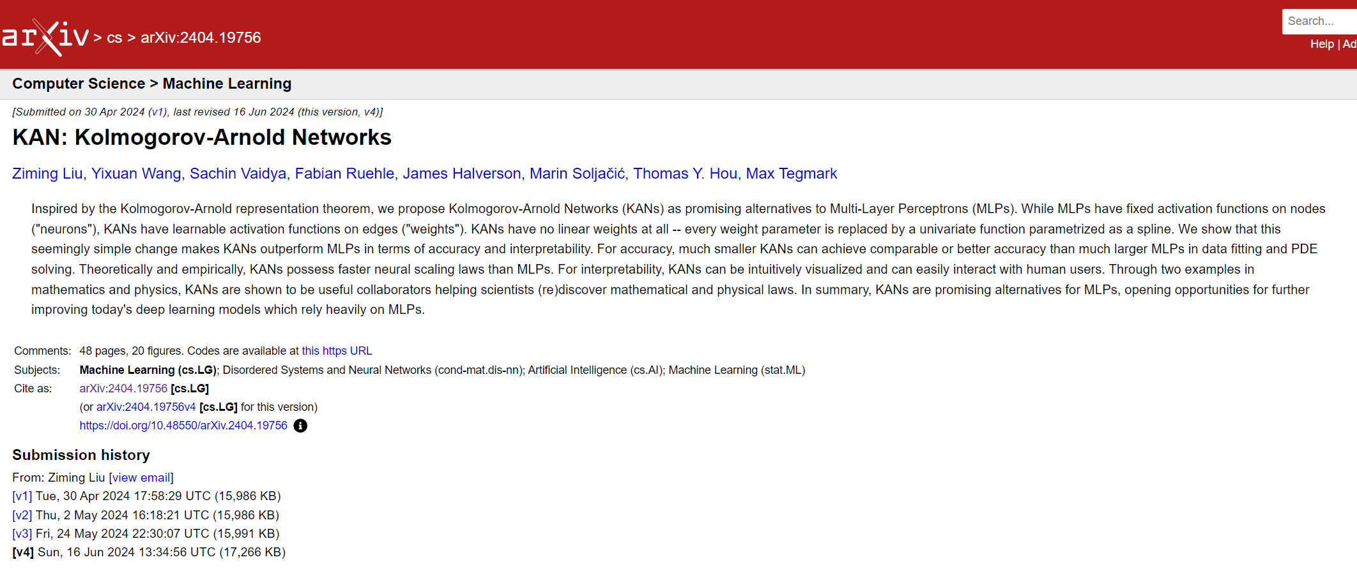

Slide 3
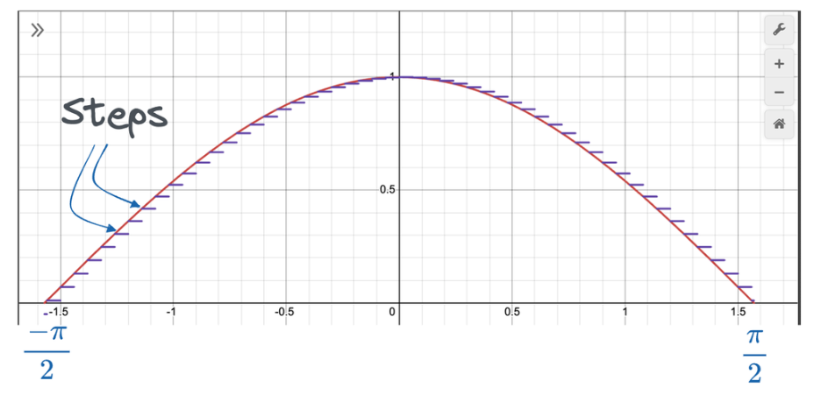
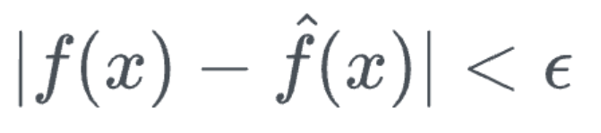
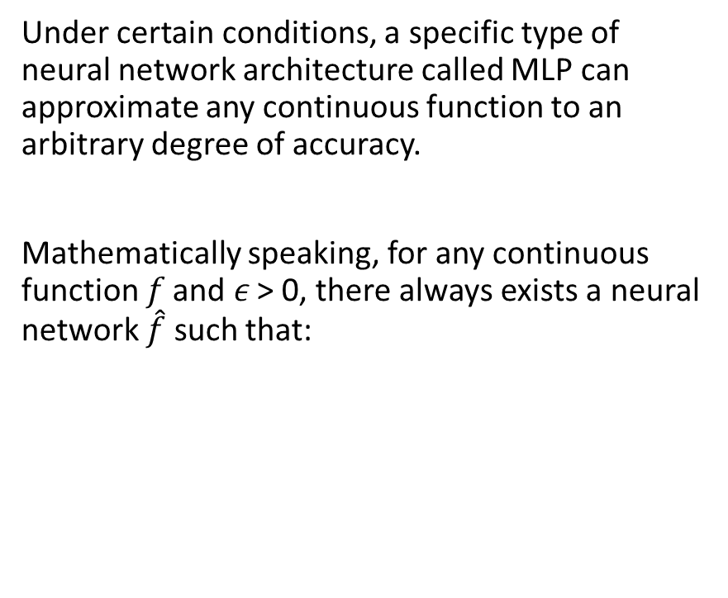
Universal Approximation Theorem
Under certain conditions, a specific type of neural network architecture called MLP can approximate any continuous function to an arbitrary degree of accuracy.
Mathematically speaking, for any continuous function 𝑓 and 𝜖 > 0, there always exists a neural network $\hat{\text{f}}$ such that:

Slide 4
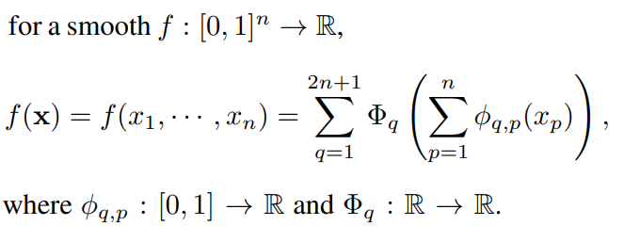
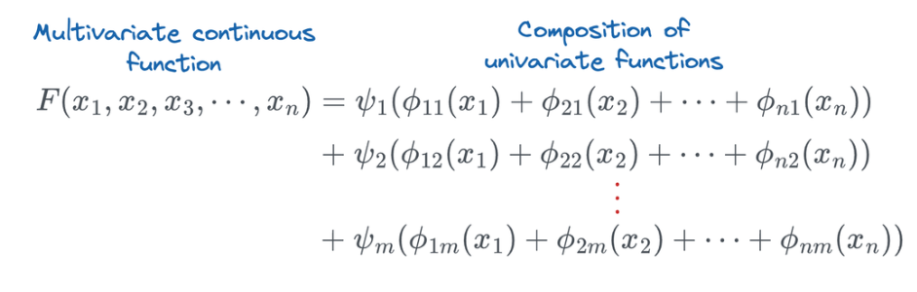
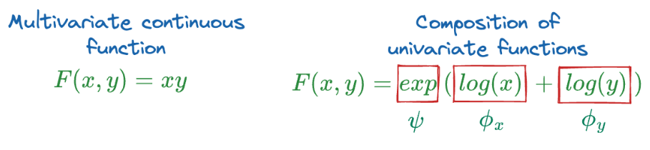
Kolmogorov-Arnold theorem
Vladimir Arnold and Andrey Kolmogorov established that if f is a multivariate continuous function on a bounded domain, then f can be written as a finite composition of continuous functions of a single variable and the binary operation of addition.
these 1D functions can be non-smooth and even fractal
sentenced to death in machine learning, regarded as theoretically sound but practically useless !!!

Slide 5
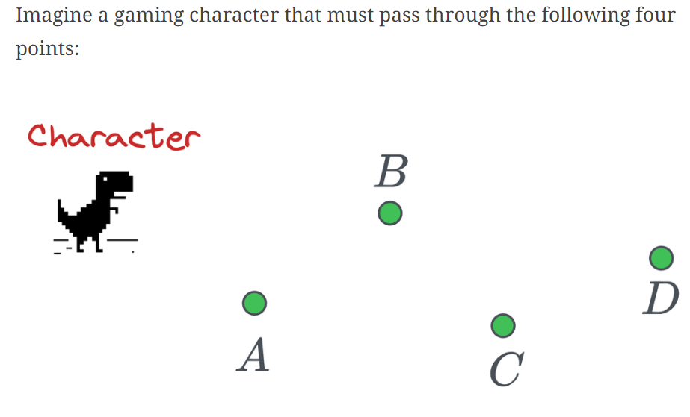
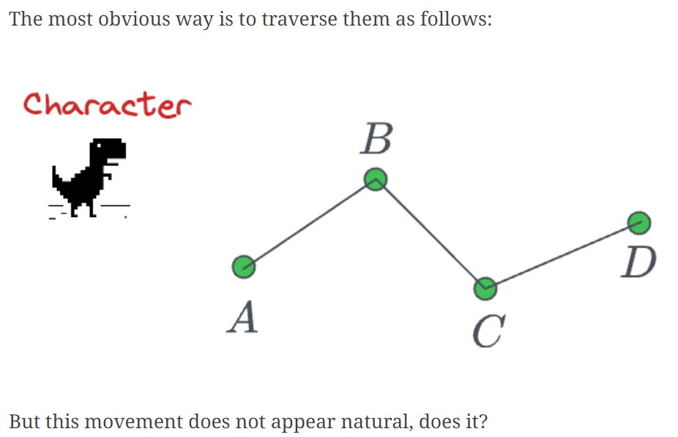
Bezier curves

Slide 6
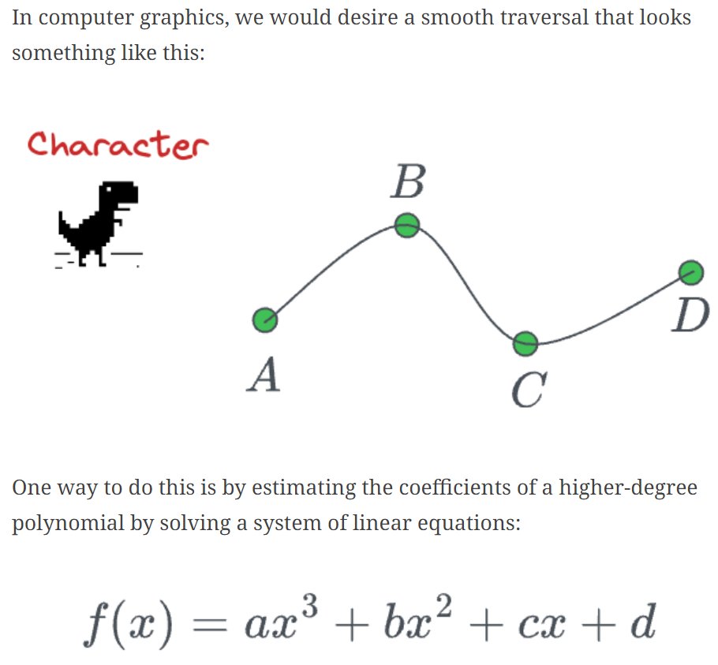
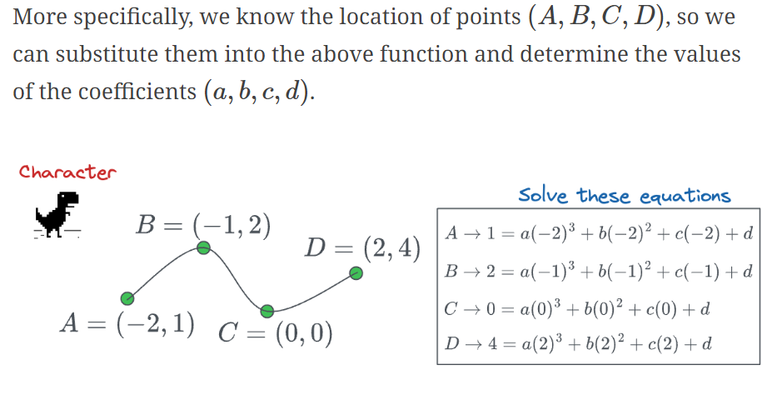
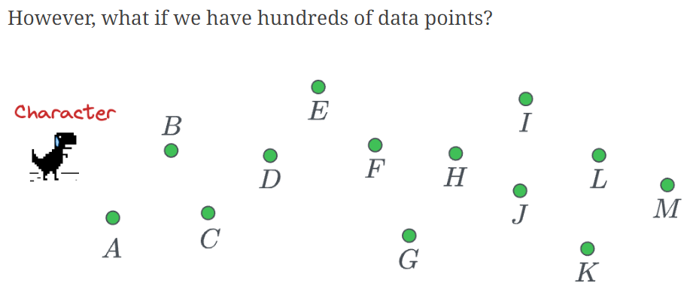
Bezier curves

Slide 7
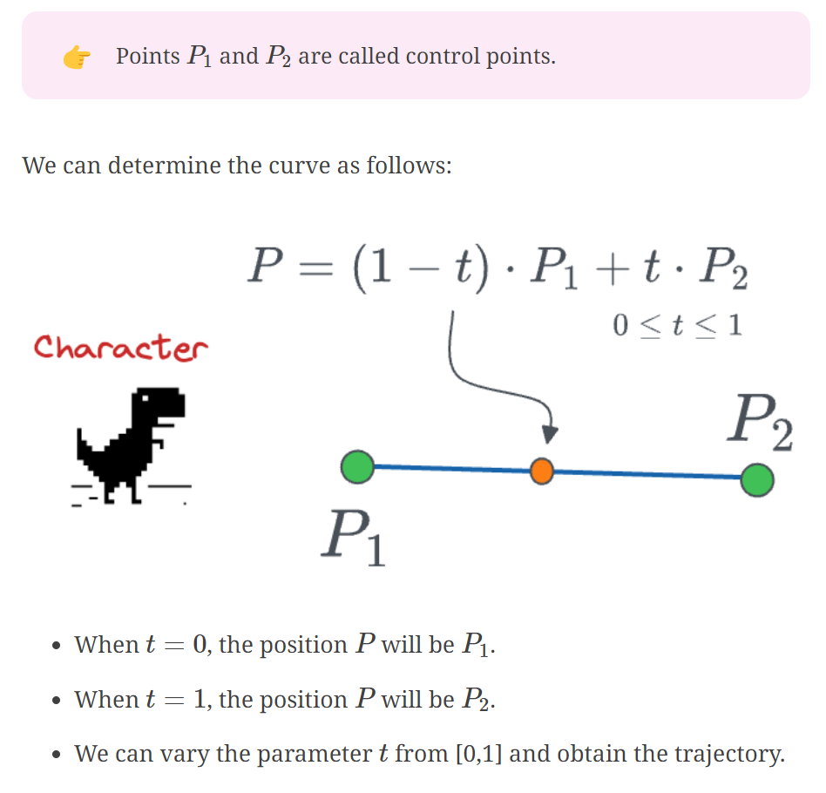
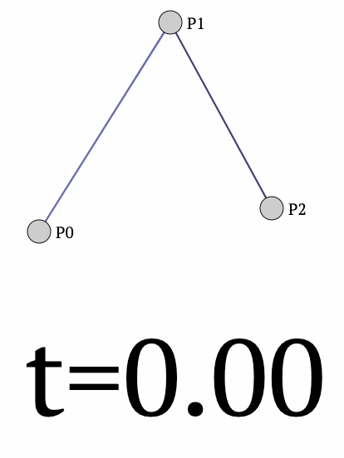
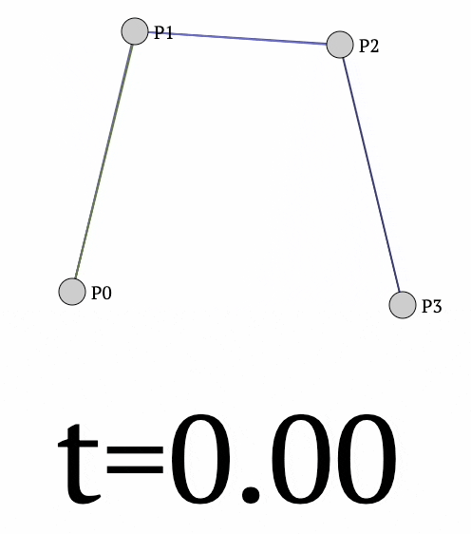
Bezier curves

Slide 8
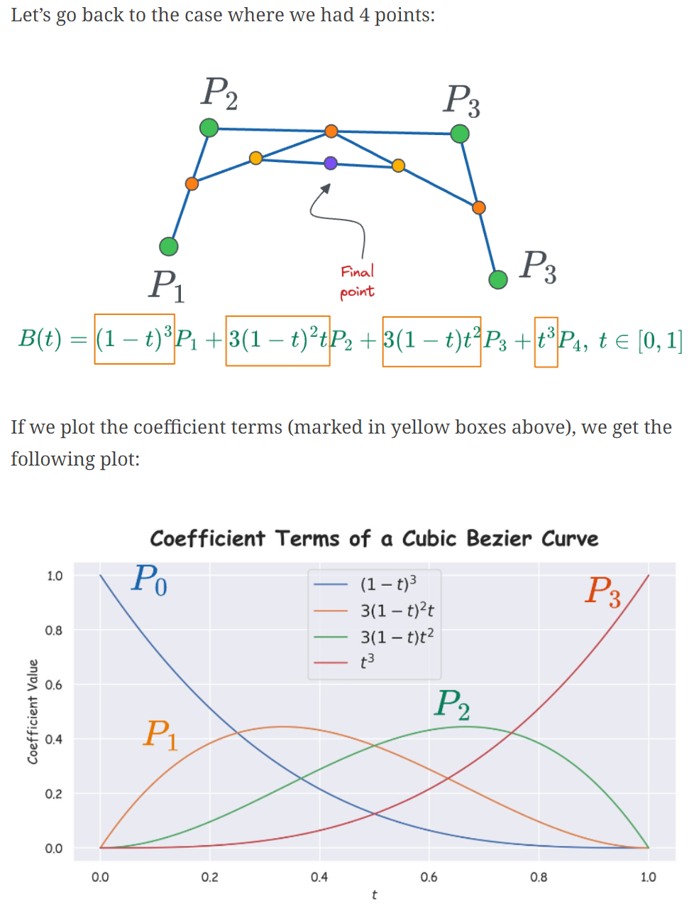
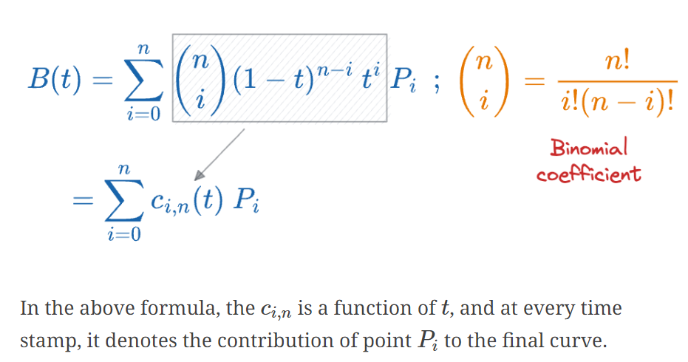
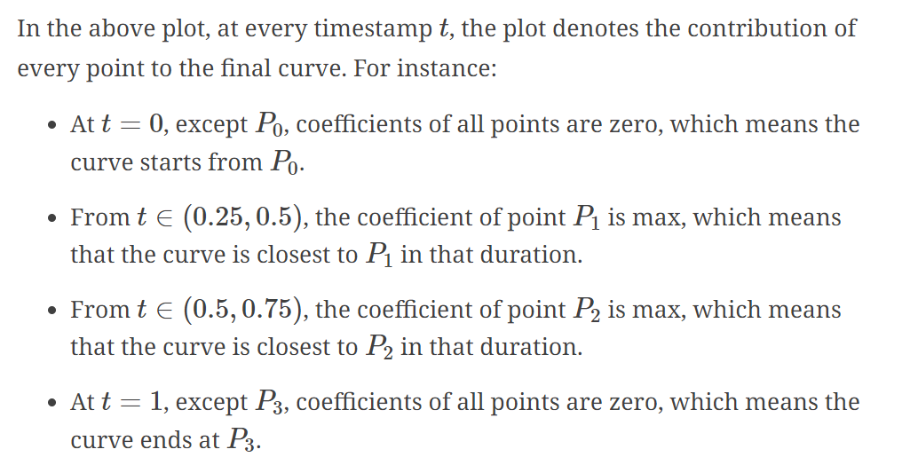
Bezier curves

Slide 9
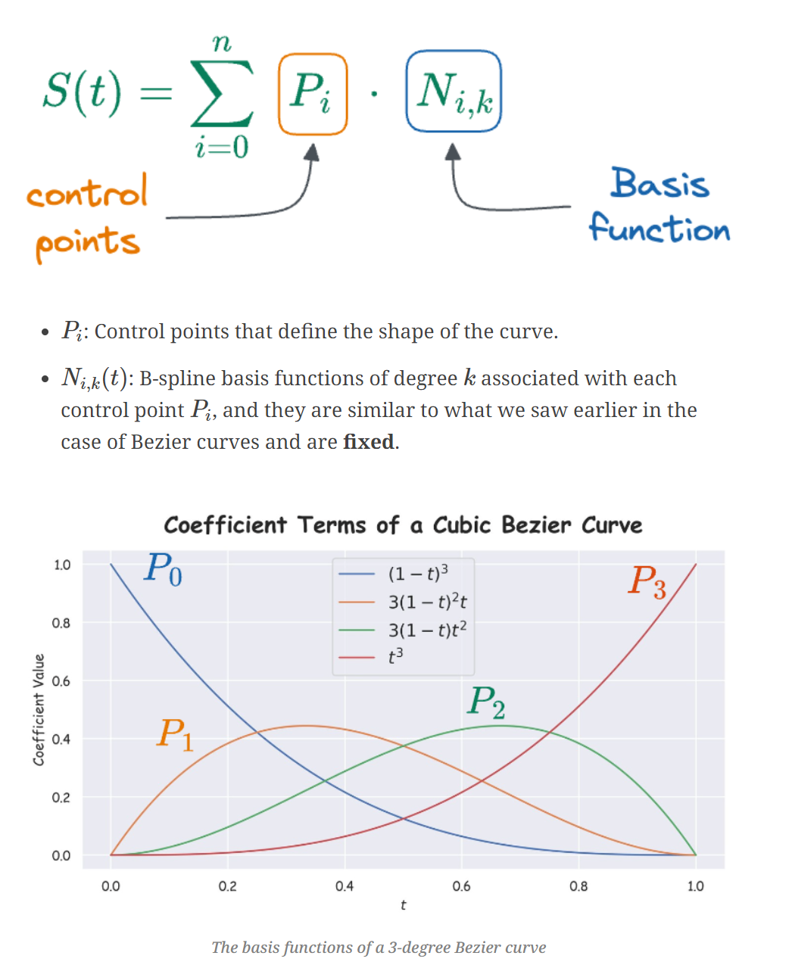
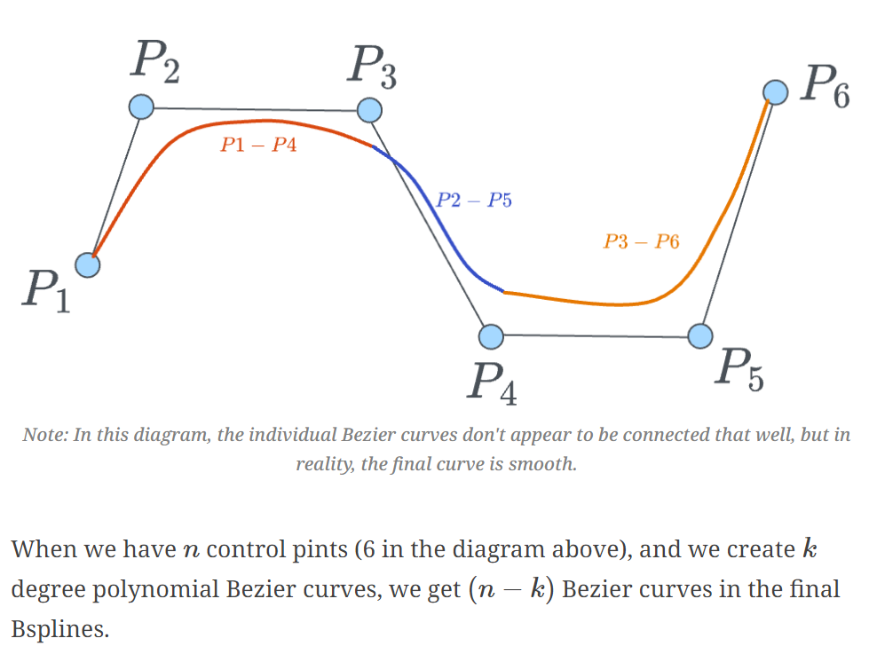
(Basis/B) Splines
Mathematical functions that's used to connect data points smoothly by connecting simpler polynomial functions (basis functions).

Slide 10
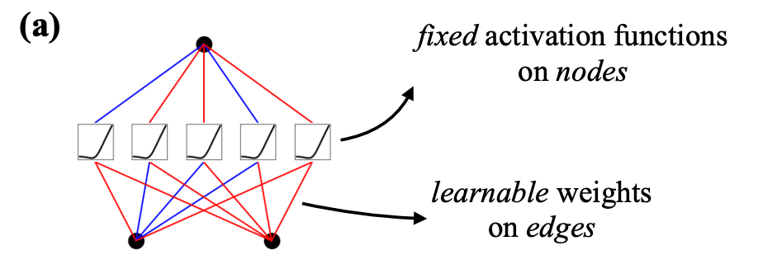
MLPs
Fully-connected feedforward neural networks
Expressive power guaranteed by the universal approximation theorem
Significant drawbacks
Efficiency: In transformers for example, MLPs consume almost all non-embedding parameters
Interpretability: typically less interpretable (relative to attention layers) without post-analysis tools

Slide 11
Splines vs MLPs
Splines:
Strengths:
Accurate for low-dimensional functions (functions with few variables).
Easy to adjust locally (fine-tune specific parts of the function).
Flexible resolution (can represent functions with varying levels of detail).
Weakness:
Curse of dimensionality (become very complex and inefficient for high-dimensional functions - functions with many variables).
MLPs:
Strength:
Less susceptible to the curse of dimensionality due to their ability to learn features (identify patterns within the data).
Weakness:
Less accurate than splines in low dimensions because they can't perfectly optimize simple functions involving single variables.
KANs combine the strengths of both approaches

Slide 12
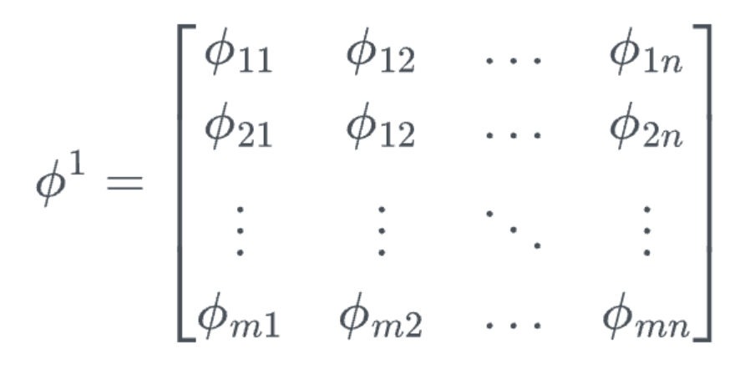
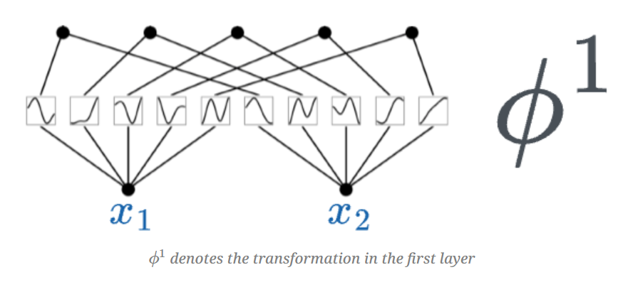
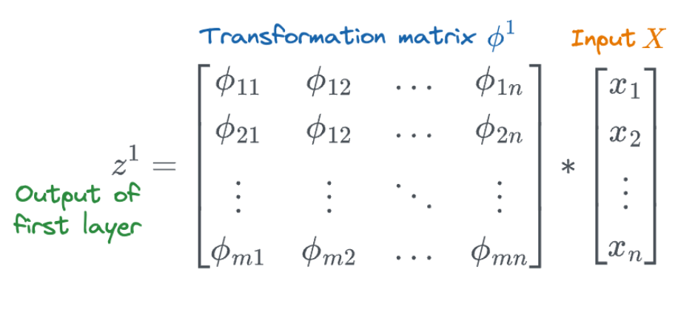
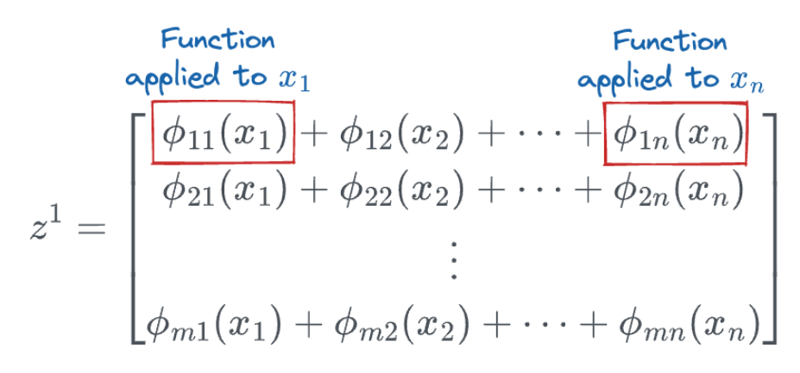
One layer of KAN
What is a layer of KAN?
𝑛 denotes the number of inputs.
𝑚 denotes the number of output nodes in that layer.

Slide 13
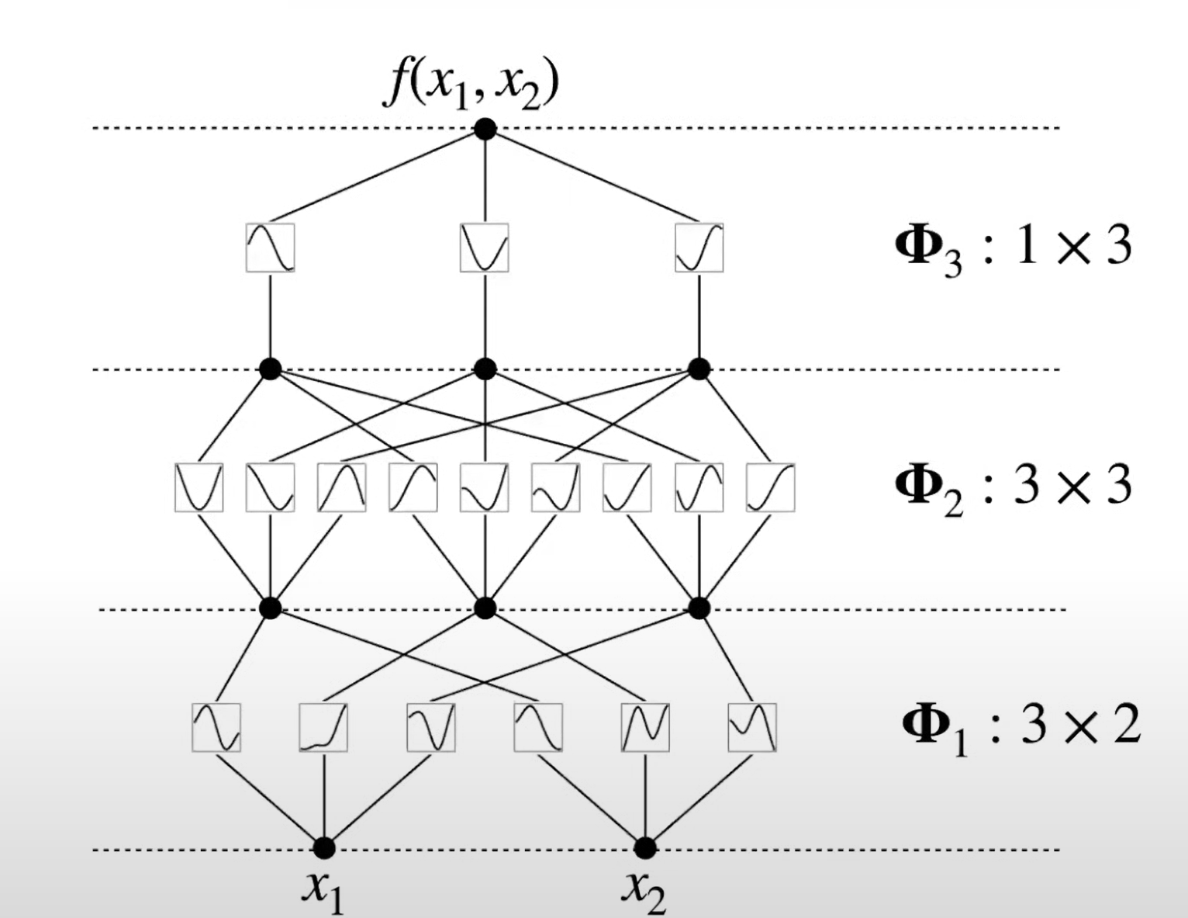
Deeper KAN
Layers can be stacked
Scalability proof

Slide 14
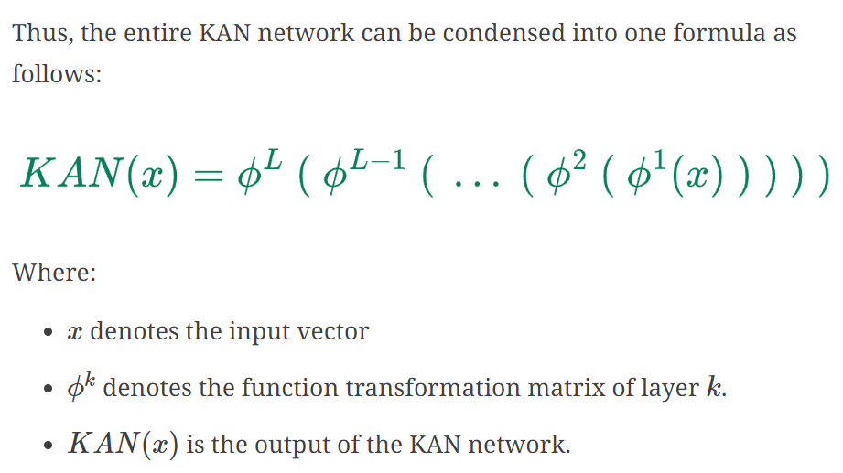
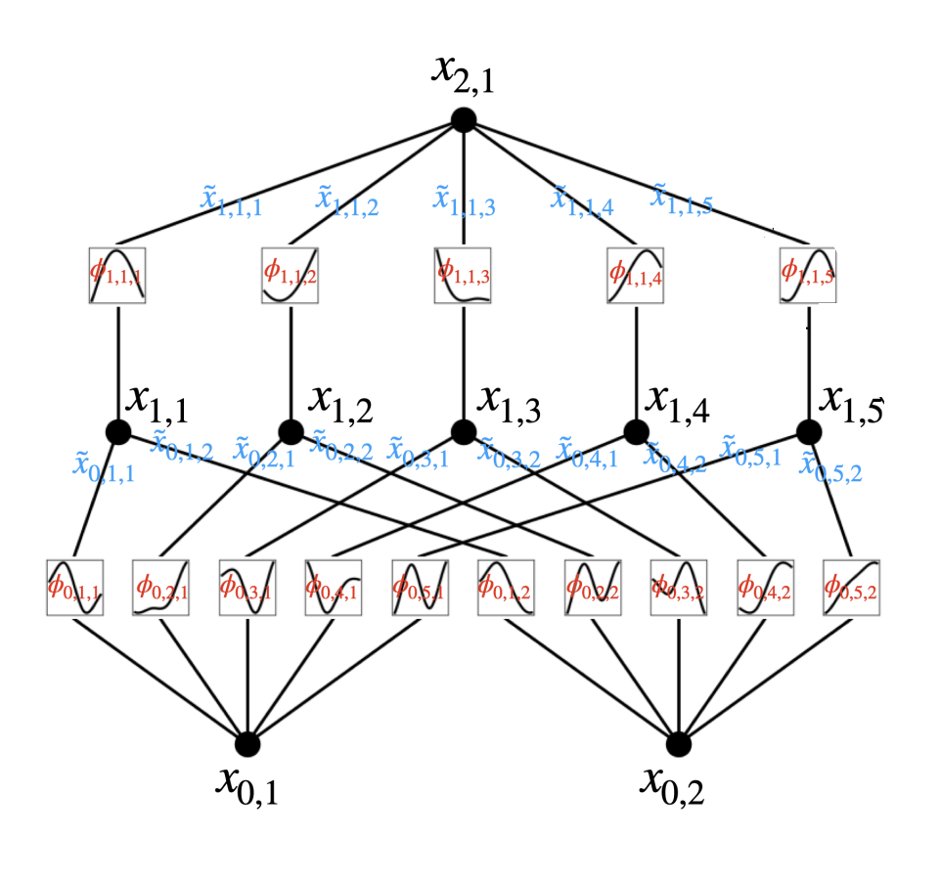
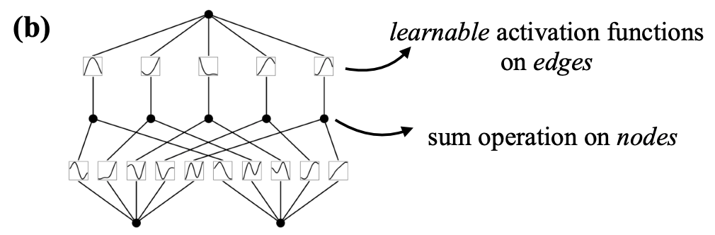
KAN architecture

Slide 15

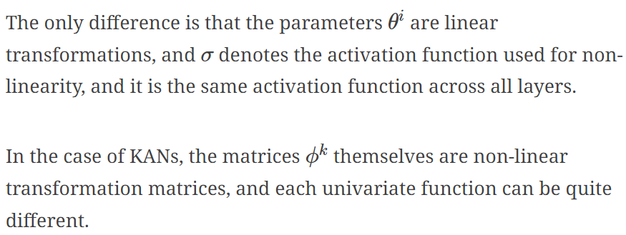
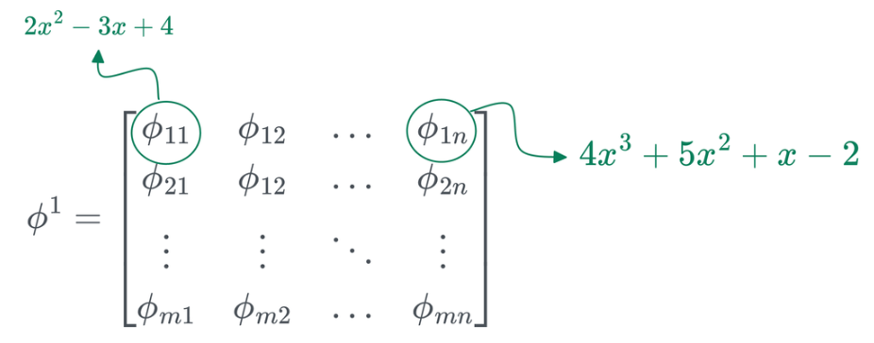
KAN formula vs MLP formula

Slide 16
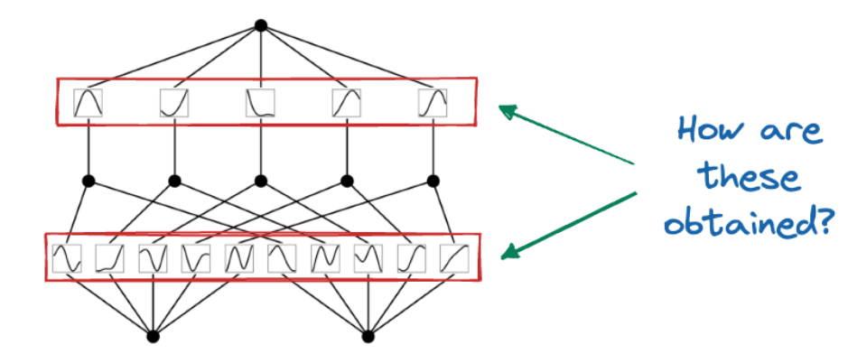
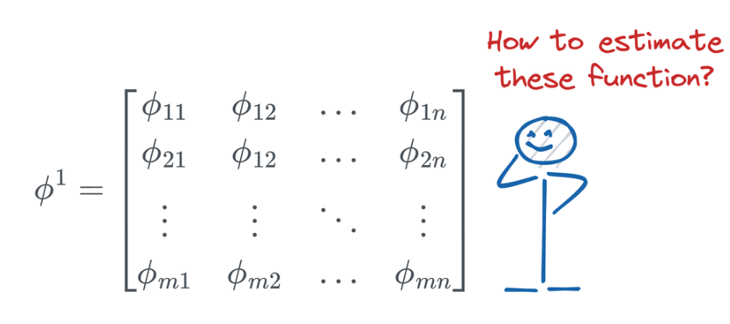
KAN architecture
Parametrize each 1D function as a B-spline curve
Coefficients as Learnable Parameters

Slide 17
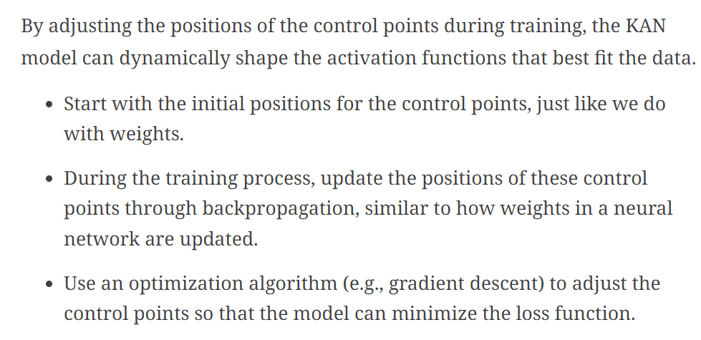
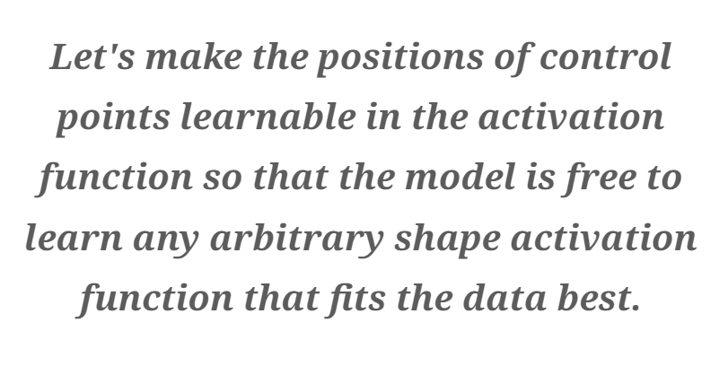
KAN architecture

Slide 18
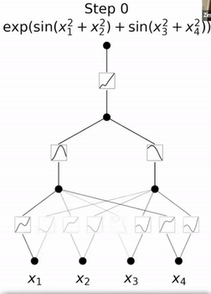
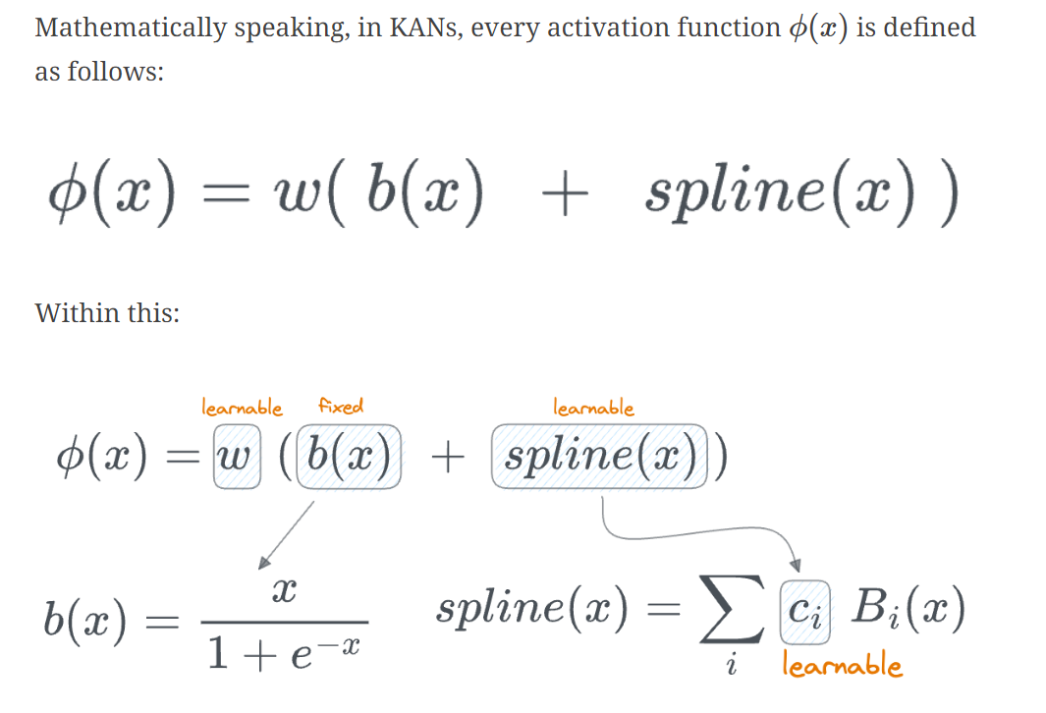
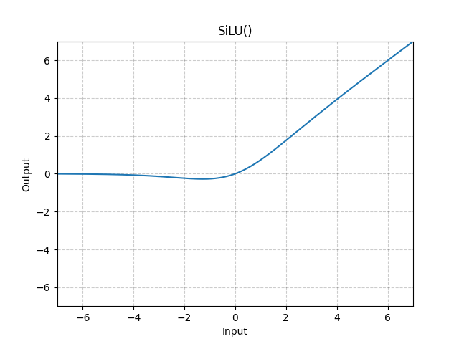
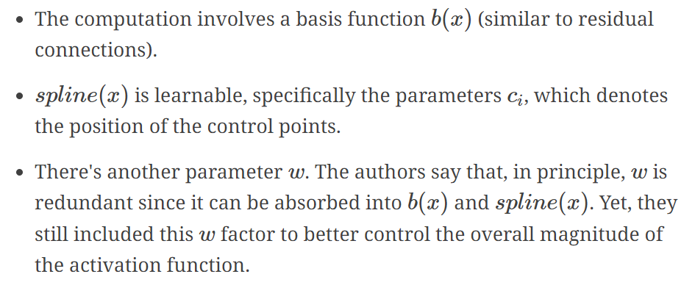
KAN architecture

Slide 19
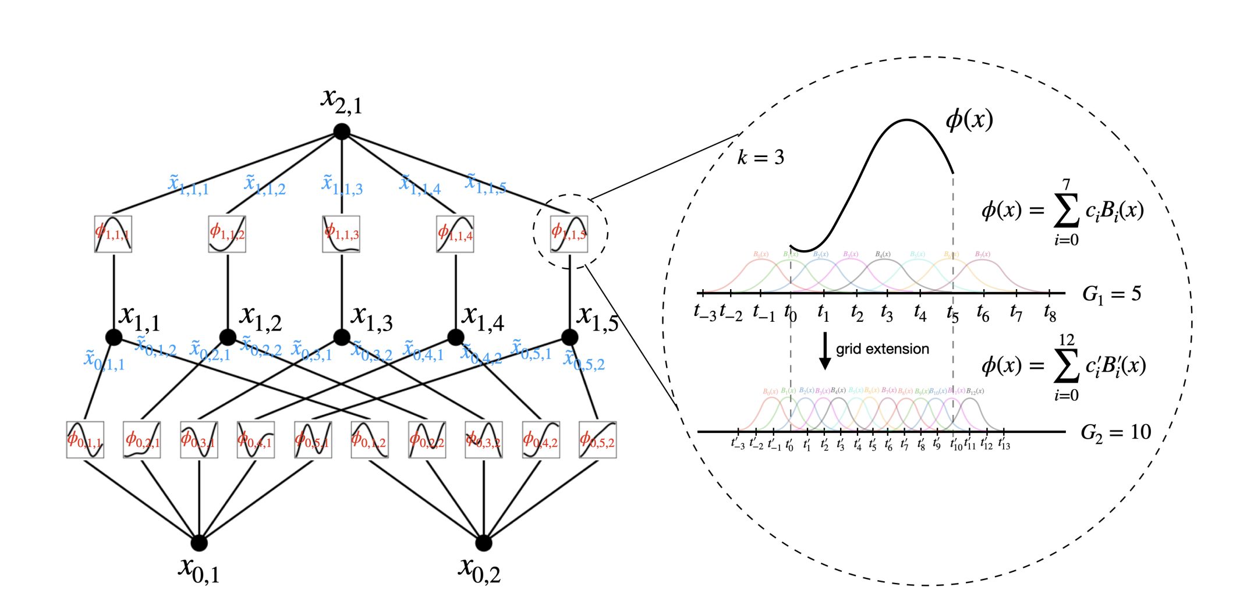
KAN architecture

Slide 20
Grid Extension

Slide 21
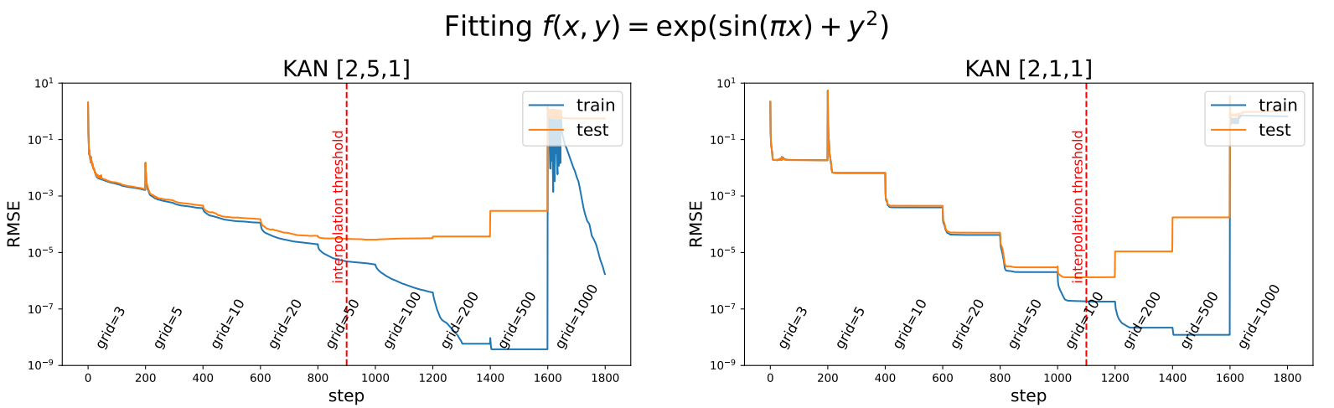
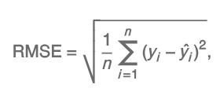
Grid Extension

Slide 22
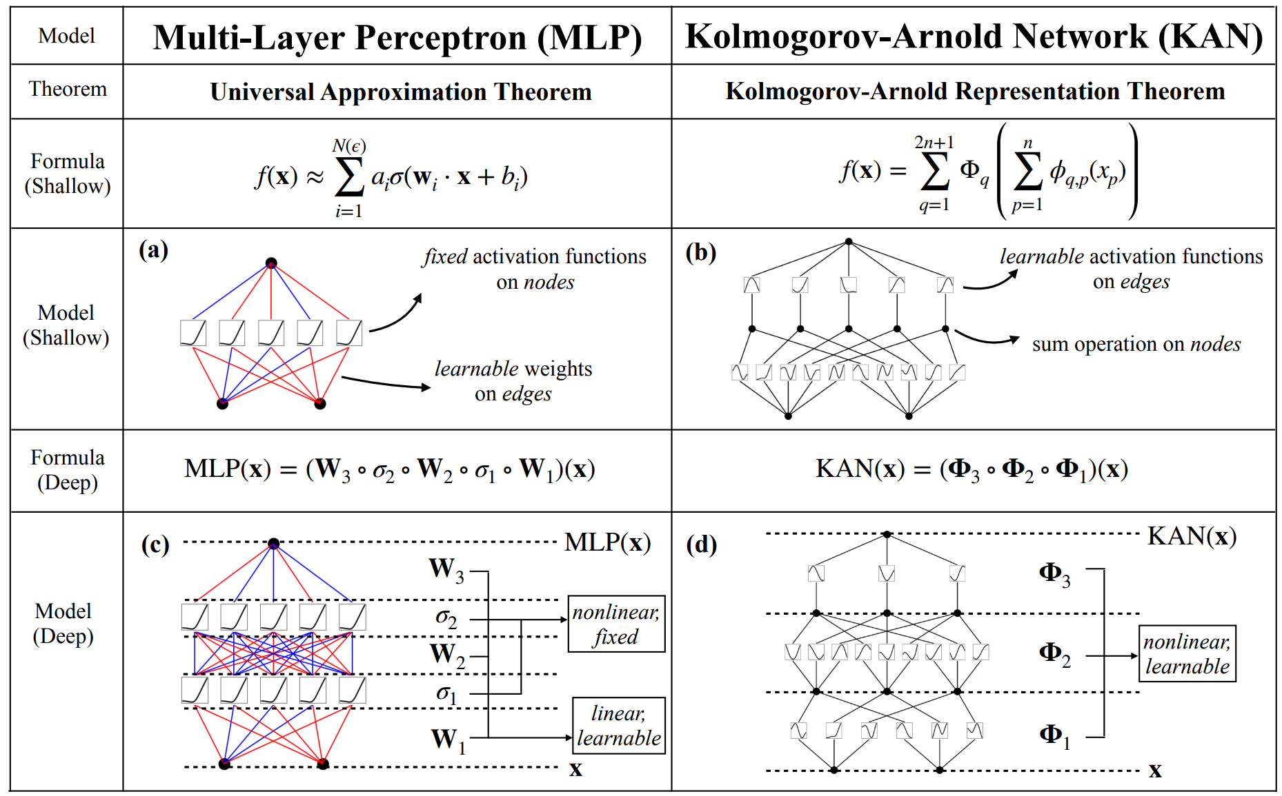
MLP vs KAN

Slide 23
MLP vs KAN
MLP | KAN
Universal approximation theorem | Kolmogorov-Arnold representation theorem
Less interpretable | Interpretable
More parameters | Less parameters
Place fixed activation functions on nodes (“neurons”) | Place learnable activation functions on edges (“weights”)
Have linear weight matrices | Each weight parameter is replaced by a learnable 1D function parametrized as a spline
Nodes sum incoming signals with applying non-linearities. | Nodes sum incoming signals without applying any non-linearities.

Slide 24
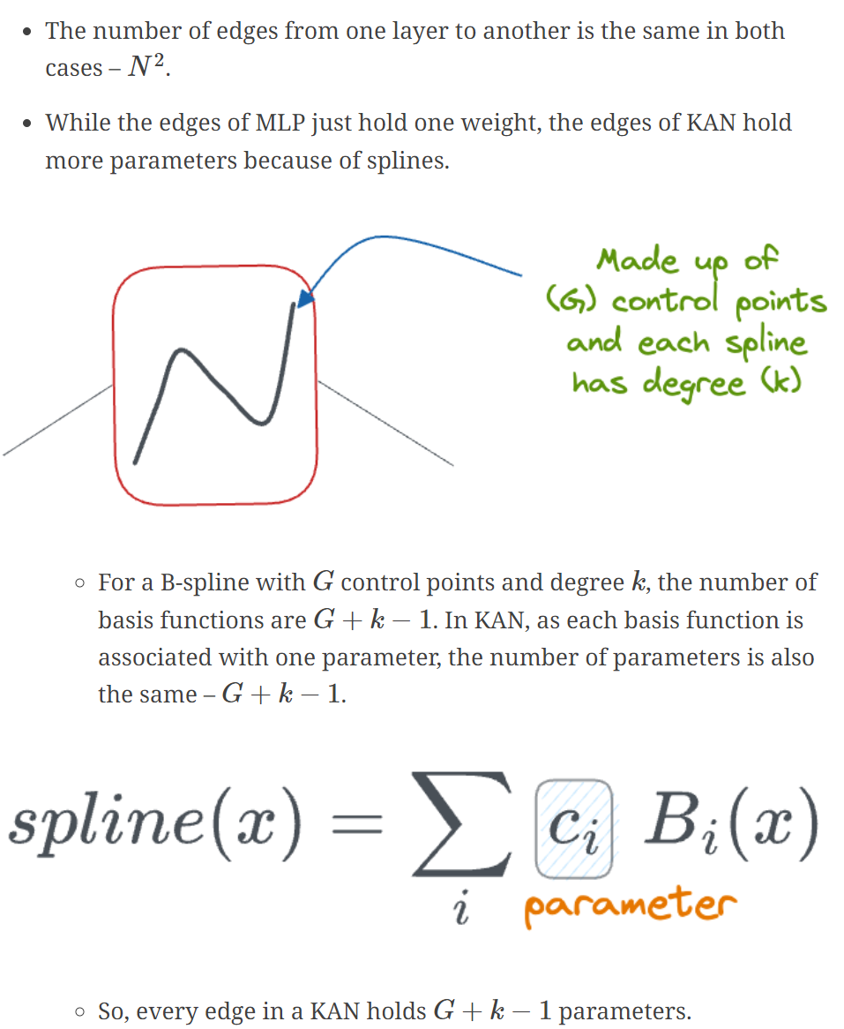
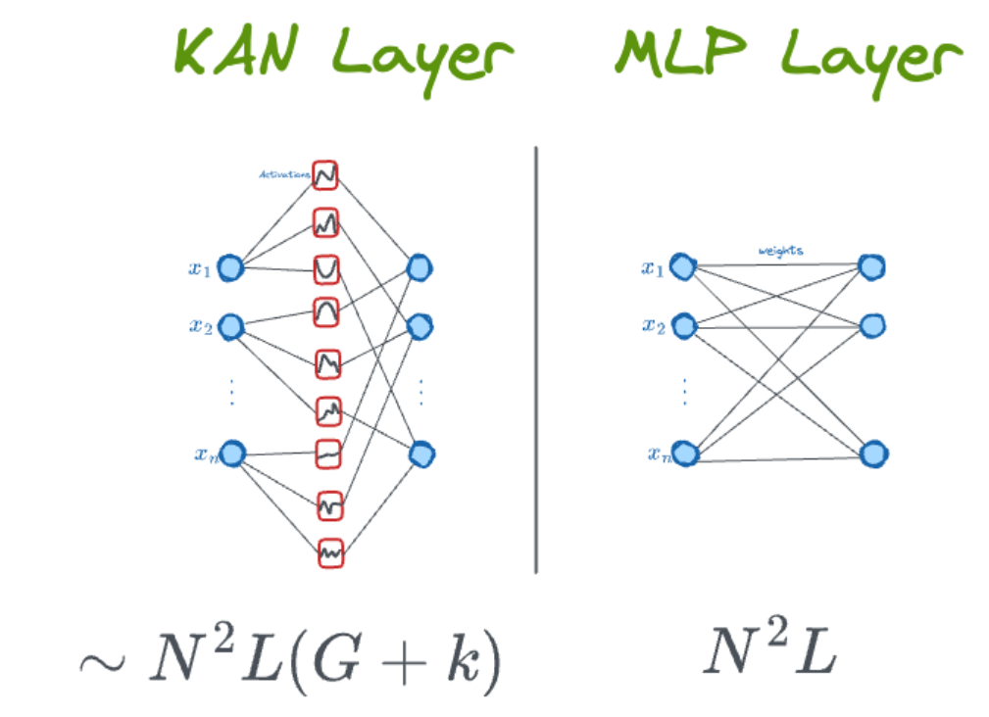
MLP vs KAN: Parameter count
So why they say it is better?
Because it is more expressive and can solve the same problem using less parameters or layers

Slide 25
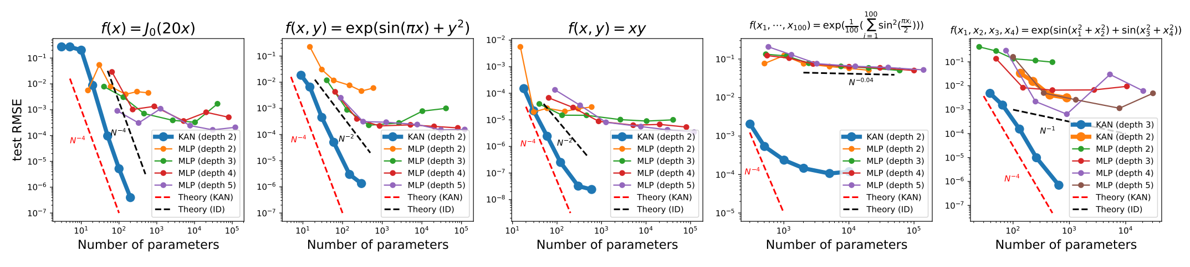
Results

Slide 26
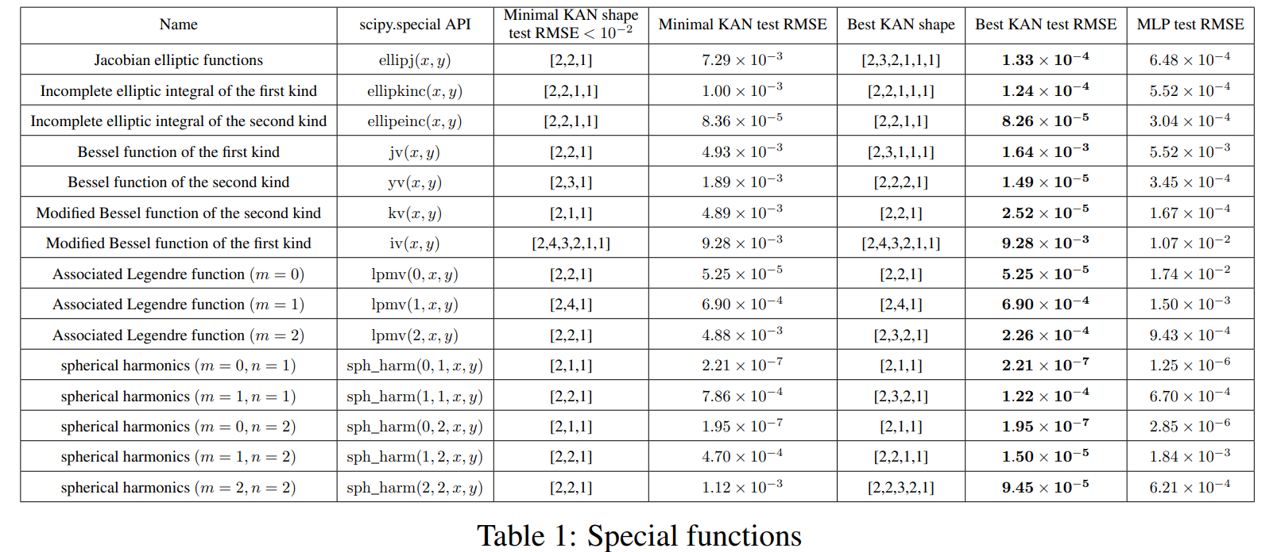
Results

Slide 27
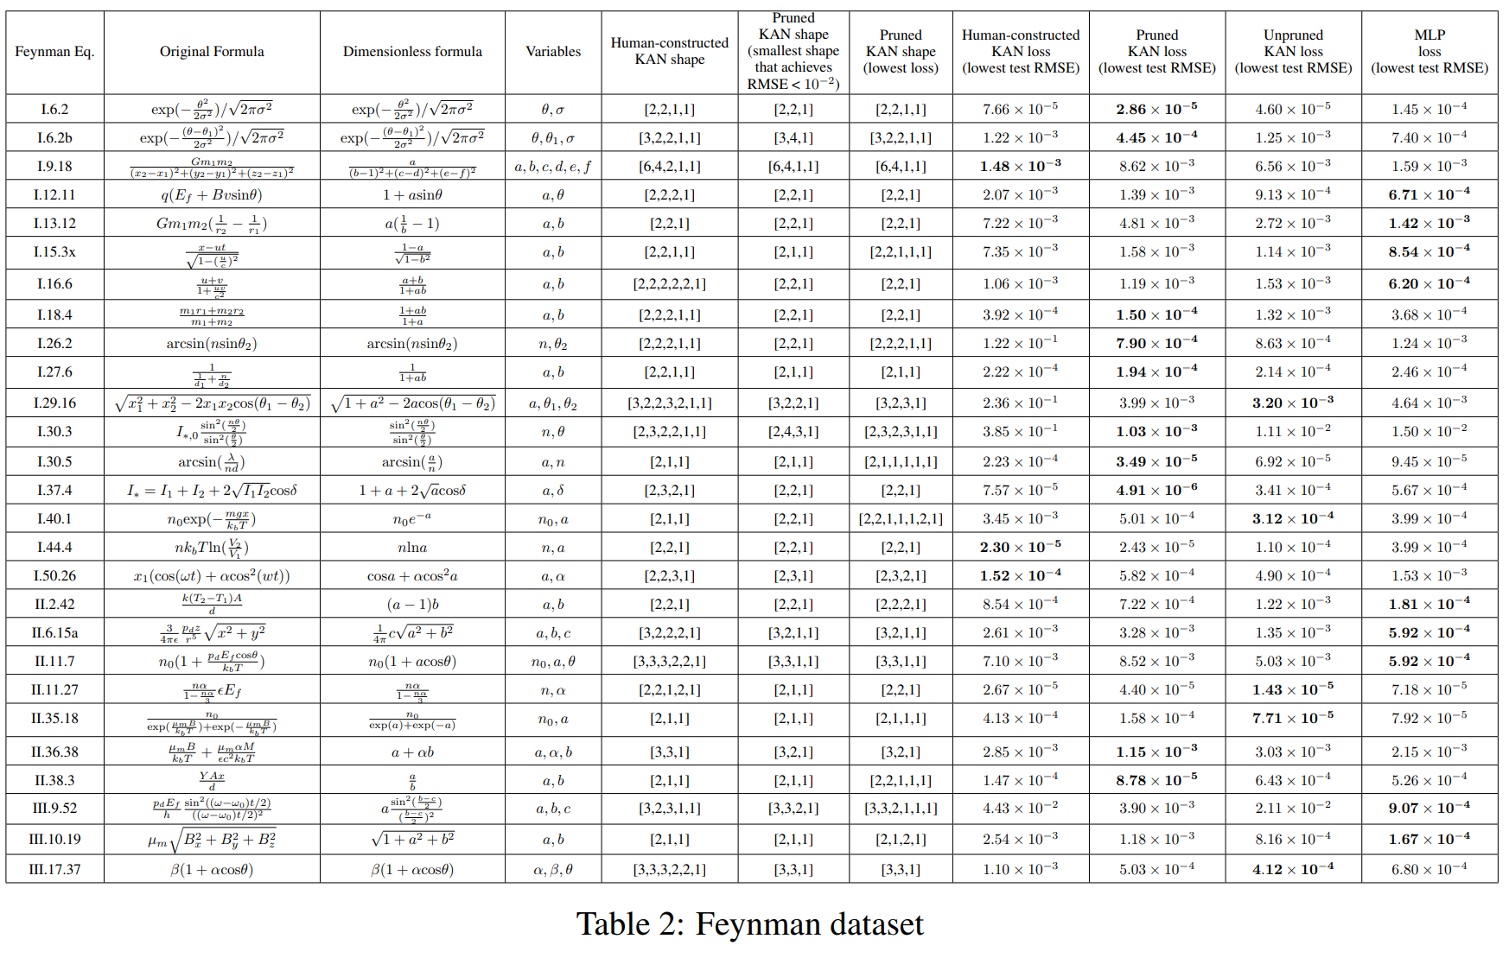
Results

Slide 28
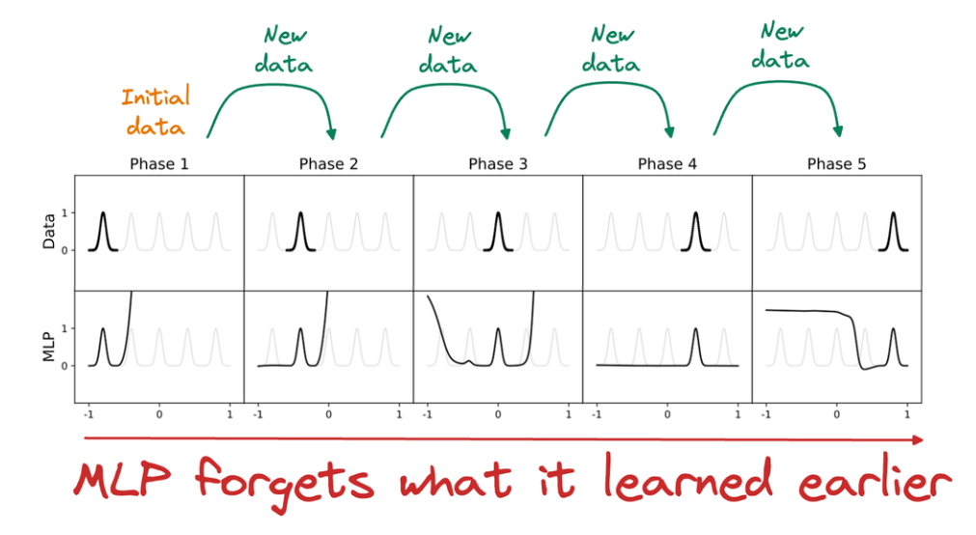


Continual Learning
Why it does not forget?
Notion of locality-storage of knowledge

Slide 29

Interpretability

Slide 30


Simplification

Slide 31

Run-time
They noticed that KANs are usually 10x slower than MLPs
The authors mention that they did not try much to optimize KANs’ efficiency, and they treat bottlenecks more like an engineering problem, which can be improved in future iterations of KAN released by them or the community.

Slide 32

Conclusion
Scalability proof??

Slide 33

Thank You

